Slide 1
Overview Over Attack Vectors and Countermeasures for Buffer Overflows
Valentin Brandl
Wissenschaftliches Seminar
Faculty of Computer Science and Mathematics
OTH Regensburg

Slide 2
Topics
Motivation
Technical Overview
Ways of Exploiting Buffer Overflows
Analyzed Countermeasures
Discussion
<number>

Slide 3
Motivation
14% of CVEs in 2018 were BOF
Concerns languages with manual memory management (C, C++, Fortran)
Second most used programming language: C (2019)
https://www.cvedetails.com/vulnerability-list/year-2018/opov-1/overflow.html, https://www.tiobe.com/tiobe-index/
<number>

Slide 4
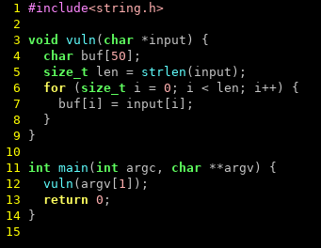
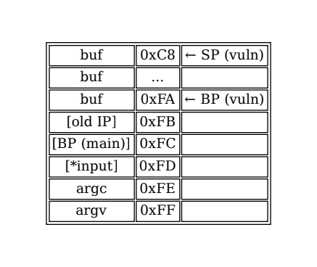
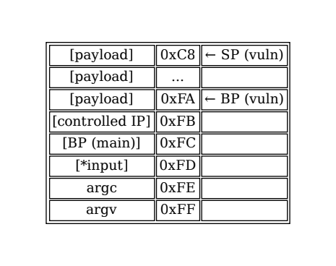
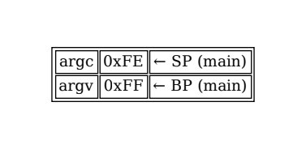
Technical Overview
<number>

Slide 5
Technical Overview
Attacker overwrites any kind of function pointer (return address, VMT, …)
Attacker places payload in memory or reuses existing code
When function pointer is used, attacker gains code execution
DoS is also possible by accessing invalid memory
https://www.cvedetails.com/vulnerability-list/year-2018/opov-1/overflow.html, https://www.tiobe.com/tiobe-index/
<number>

Slide 6
ASLR
Randomize location of program in memory
Attacker doesn‘t know where payload is located
Prevents code execution
Information leak allows exploitation
Brute-force of 32 bit addresses possible
Does not prevent DoS
Compile-time mitigation, no code changes needed
<number>

Slide 7
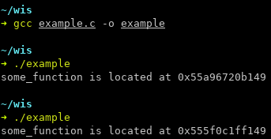
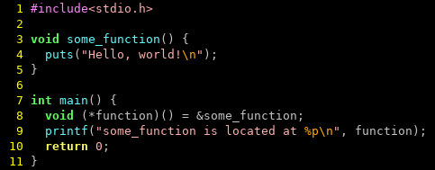
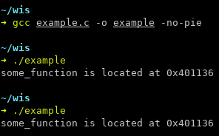
ASLR
<number>

Slide 8
NX
Memory can be either writable or executable
Attacker cannot supply shellcode directly
Code reuse still possible
Compile-time mitigation, no code changes needed
<number>

Slide 9
Stack Canary
Markers at the end of a stack frame
Invalid marker → Buffer overflow occurred
No code changes required
Only mitigates stack-based BOF
Knowledge of canary allows bypassing
<number>

Slide 10
RAD
Read-only stack for return addresses
Compared before return
Compiler extension
Only against stack-based BOF
<number>

Slide 11
Bounds Checking
Each indexing operation is checked
100% effective (where applied)
Non-trivial runtime overhead
Used in languages with runtimes (Java, C#, Python, …)
<number>

Slide 12
Dependent Types
Value (size) is associated with a buffer
Only allow indexing with validated values
Language extension
Lot of work to use, but type inference helps
<number>

Slide 13
State of the Art
Major OS implement ASLR
Compilers implement PIE, NX, Stack Canaries (discussable defaults)
Mitigation | GCC? | clang?
PIE | No | No
NX | Yes | Yes
Stack Canary | No | No
<number>

Slide 14
State of the Art
Most techniques only prevent exploitation (code execution)
DoS might be just as critical (aviation, autonomous driving, ...)
Only dependent typing and RBC actually prevent BOF
<number>

Slide 15
Conclusion
Use C, C++ and Fortran only if unavoidable and enable compiler mitigations
Viable alternatives exist (Rust, Go, Java, ...)
<number>

Slide 16
Thank you for listening
<number>

