Slide 1
Notes:
Motivation Morris Wurm

Slide 2
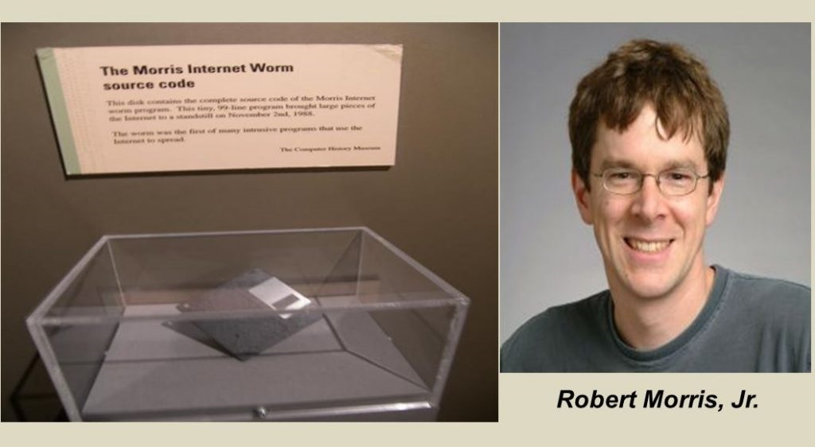
Ref.: [11], [12]
Notes:
- 1988 als erster Wurm im Internet
Bassiert auf Stack-based buffer overflow
Auch heute noch großes Thema da
C / C++ noch oft verwendet wird
IoT

Slide 3
Overview Over Attack Vectors And Countermeasures For Buffer Overflows
Christian Müller | Julian Dietrich | Valentin Brandl
Faculty of Computer Science and Mathematics
OTH Regensburg
Notes:
Überleitung: Agenda

Slide 4
Agenda
Attack Vectors
Counter-measures
Discussion
Methods Of Research
Notes:
Forschungsmethoden
Angriffsszenarien
Schutzmaßnahmen
Diskussion und Ausblick
Überleitung: Angriffsmöglichkeiten

Slide 5
Methods Of Research
Paper
Snowball- System
Online- Research
Get Overview By Survey Papers
Methods of Research → Attack Vectors → Countermeasures → Discussion
Notes:
FORSCHUNGSMETHODEN
1) Über Survey-Paper ersten groben Überblick bekommen
2) Auf [1] basierendes Schneeballsystem, weil
Survey-Paper
State-of-the-art- Paper
3) Google- Suche mit Schlüsselwörtern
Buffer-overflow
Buffer-overrun

Slide 6



Attack Vectors
Stack-based buffer overflows
Heap-based buffer overflows
Integer overflows
Methods of Research → Attack Vectors → Countermeasures → Discussion

Slide 7
Attack Vectors
Stack-based buffer overflows
Stack contains: Parameters, Local Variables, Return Address, …
Return Address: Next address to execute when called function returns
Local Variables: Can contain function pointers
General Goal: Overwriting Return Address or Local Function Pointers to gain Code Execution
Methods of Research → Attack Vectors → Countermeasures → Discussion

Slide 8
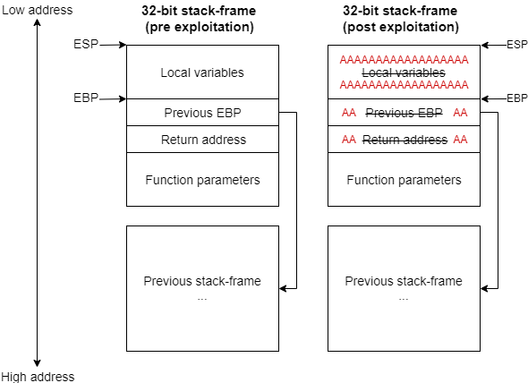
Attack Vectors
Stack-based buffer overflows
Methods of Research → Attack Vectors → Countermeasures → Discussion
Notes:
LEFT: Basic structure of a 32-bit stack-frame on the x86 architecture
RIGHT: An exploited stack-frame overwritten by a stack-based BOF using multiple A’s to change the return-address to 0x41414141

Slide 9
Attack Vectors
Heap-based buffer overflows
Heap contains: Class Instances, Function Pointers, Heap Metadata, …
Heap Metadata: Used by Heap Management operations such as freeing, merging, splitting chunks
Type confusion: Modify internal Object Type stored by dynamic typing languages such as Python or JavaScript
General Goal: Overwriting Function Pointers or Heap Metadata to gain Code Execution
Methods of Research → Attack Vectors → Countermeasures → Discussion

Slide 10
Attack Vectors
Integer overflows
Does not directly lead to Code Execution
Used to trigger Heap-based BOFs (buffer overflows)
→ Overflow integer which determines allocation size
→ Integer is smaller than needed size
➔ Out of bounds access
General Goal: Triggering a Heap-based BOF to gain Code Execution
Methods of Research → Attack Vectors → Countermeasures → Discussion

Slide 11
ASLR
Randomize location of program in memory
Attacker doesn‘t know where payload is located
Prevents code execution
Information leak allows exploitation
Brute-force of 32 bit addresses possible
Does not prevent DoS
Compile-time mitigation, no code changes needed
11
Methods of Research → Attack Vectors → Countermeasures → Discussion

Slide 12
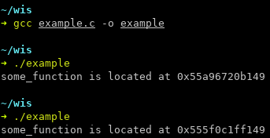
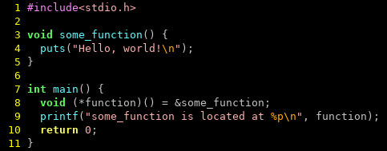
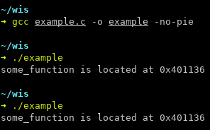
ASLR
12
Methods of Research → Attack Vectors → Countermeasures → Discussion

Slide 13
NX
Memory can be either writable or executable
Attacker cannot supply shellcode directly
Code reuse still possible
Compile-time mitigation, no code changes needed
13
Methods of Research → Attack Vectors → Countermeasures → Discussion

Slide 14
Stack Canary
Markers at the end of a stack frame
Invalid marker → Buffer overflow occurred
No code changes required
Only mitigates stack-based BOF
Knowledge of canary allows bypassing
14
Methods of Research → Attack Vectors → Countermeasures → Discussion

Slide 15
RAD
Read-only stack for return addresses
Compared before return
Compiler extension
Only against stack-based BOF
15
Methods of Research → Attack Vectors → Countermeasures → Discussion

Slide 16
Bounds Checking
Each indexing operation is checked
100% effective (where applied)
Non-trivial runtime overhead
Used in languages with runtimes (Java, C#, Python, …)
16
Methods of Research → Attack Vectors → Countermeasures → Discussion

Slide 17
Dependent Types
Value (size) is associated with a buffer
Only allow indexing with validated values
Language extension
Lot of work to use, but type inference helps
17
Methods of Research → Attack Vectors → Countermeasures → Discussion

Slide 18
Discussion – Static Methods
+
Wrong Positives
-
Know- How
Costs
Access To Source-Code
Ref.: [1], [8], [9],
lkajd[10], [11]
Methods of Research → Attack Vectors → Countermeasures → Discussion
Notes:
ALLGEMEIN
Jede Technik hat Vor- und Nachteile
Einige Compiler-basierte Techniken wurden geknackt (StackGuard, StackShield)
Erhöhter Speicherbedarf (-> IoT) für techniken, welche nach verifizierungs- Prinzip arbeiten (canary, DIFT)
ÜBERLEITUNG: statische Methoden

Slide 19
Discussion – Static Methods
+
Wrong Positives
-
Know- How
Costs
Access To Source-Code
Ref.: [1], [8], [9],
lkajd[10], [11]
Methods of Research → Attack Vectors → Countermeasures → Discussion
Notes:
Generelle Schwächen von statischen Methoden
Aufwand
Benötigtes Know-How
Oft Zugang zu Quellcode erforderlich

Slide 20
Discussion – Static Methods
+
Wrong Positives
-
Know- How
Costs
Access To Source-Code
Ref.: [1], [8], [9],
lkajd[10], [11]
Methods of Research → Attack Vectors → Countermeasures → Discussion
Notes:
Program Analysis
Hohe Fehlerkennungsraten bei der Erkennung tatsächlicher Überläufe
Großer Aufwand für Techniken wie delta debugging oder dynamic slicing
Hohe Zuverlässigkeit für Schwachstellenerkennung
delta debugging oder dynamic slicing können die Tatsächliche Ursache des Fehlers finden
program transformation kann diese sogar automatisiert fixen

Slide 21
Discussion – Static Methods
+
Wrong Positives
-
Know- How
Costs
Access To Source-Code
Ref.: [1], [8], [9],
lkajd[10], [11]
Methods of Research → Attack Vectors → Countermeasures → Discussion
Notes:
Code Inspection
Aufwand für große Software- Projekte
Hängt vom know-how des Reviewers ab
Ist bereits Teil vieler Entwicklungsprozesse

Slide 22
Discussion – Static Methods
+
Wrong Positives
-
Know- How
Costs
Access To Source-Code
Ref.: [1], [8], [9],
lkajd[10], [11]
Methods of Research → Attack Vectors → Countermeasures → Discussion
Notes:
Symbolic execution
Extrem hoher Aufwand der Implementierung
Sehr niedrige Fehlerkennungsraten möglich (10%)
ÜBERLEITUNG: dynamische Methoden

Slide 23
Discussion – Dynamic Methods
+
Implement-ation
-
Wrong Positives
Access To Source Code
Legacy Code
Size Of Memory
Ref.: [1], [8], [9],
lkajd[10], [11]
Methods of Research → Attack Vectors → Countermeasures → Discussion
Notes:
Generelle Schwäche von dynamischen Methoden: funktionieren oft nicht so gut:
Hohe Fehlerkennungsrate -> Ermüdung der Tester
Nahezu alle Techniken benötigen Zugang zum Quellcode
Viele benötigen spezielle Implementierungen -> Bestandscode müsste modifiziert werden

Slide 24
Discussion – Dynamic Methods
+
Implement-ation
-
Wrong Positives
Access To Source Code
Legacy Code
Size Of Memory
Ref.: [1], [8], [9],
lkajd[10], [11]
Methods of Research → Attack Vectors → Countermeasures → Discussion
Notes:
Generelle Vorteile dynamischer Methoden: Automatische Umsetzung -> Spart Geld und Zeit
Testen
Ist bereits Teil eines fast jeden Software- Entwicklungsprozesses

Slide 25
Discussion – Dynamic Methods
+
Implement-ation
-
Wrong Positives
Access To Source Code
Legacy Code
Size Of Memory
Ref.: [1], [8], [9],
lkajd[10], [11]
Methods of Research → Attack Vectors → Countermeasures → Discussion
Notes:
Modelle
Großer Aufwand zum erstellen
Hohe Fehlerkennungsrate
Danach automatisierte BO Tests möglich

Slide 26
Discussion – Dynamic Methods
+
Implement-ation
-
Wrong Positives
Access To Source Code
Legacy Code
Size Of Memory
Ref.: [1], [8], [9],
lkajd[10], [11]
Methods of Research → Attack Vectors → Countermeasures → Discussion
Notes:
Künstliche Intelligenz
Hängt von Güte der Trainingsdaten ab -> Gerade bei kleinen Codes schwierig
Mitunter aufwändige Implementierung
Arbeiten im Generellen sehr zuverlässig
Besonders gut: Erzeugung von Test- Eingaben mittels ML, danach Tests mit statischen Methoden
ÜBERLEITUNG: Ausblick

Slide 27
Discussion - Conclusion
Until today, a lot of software is developed in unprotected languages
Combination if techniques provides best results
  Computational intelligence combined with static methods
Forecast
More computational intelligence techniques
Techniques to handle buffer overflow vulnerabilities automatically
Ref.: [1], [8], [9], [10], [11]
Methods of Research → Attack Vectors → Countermeasures → Discussion
Notes:
Viel Software wird noch in ungeschützten Sprachen geschrieben
Kombination von verschieden Methoden nötig
ML und statische Methoden + sichere Compiler
Ausblick
Techniken, welche Fehler automatisch korrigieren
ML

Slide 28
References (1/2)
[1] | M. L. Chaim, D. S. Santos, and D. S. Cruzes, “What do we know about buffer overflow detection? a survey on techniques to detect a persistent vulnerability,” International Journal of Systems and Software Security and Protection (IJSSSP), 2018.
[2] | W. Wang, “Survey of attacks and defenses on stack-based buffer overflow vulnerability,” Advances in Computer Science Research (ACSR), 2017.
[3] | Y. Younan, W. Joosen, and F. Piessen, “Runtime countermeasures for code injection attacks against c and c++ programs,” ACM Computing Surveys (CSUR), 2012.
[4] | D. Brumley, T.-c. Chiueh, R. Johnson, H. Lin, and D. Song, “Rich: Automatically protecting against integer-based vulnerabilities (rich),” RICH Journal Group (RICH), 2007.
[5] | W. Dietz, P. Li, J. Regehr, and V. Adve, “Understanding integer overflow in c/c++,” ACM Trans. Softw. Eng. Methodol. (TOSEM), vol. 25, no. 1, pp. 2:1–2:29, Dec. 2015. [Online]. Available: http://doi.acm.org/10.1145/2743019
[6] | D. Binkley, “Source code analysis: A road map,” IEEE Computer Society (IEEE CS), 2007.

Slide 29
References (2/2)
[7] | M. Harman, “Why source code analysis and manipulation will always be important,” IEEE Computer Society (IEEE CS), 2010.
[8] | B. M. Padmanabhuni and H. B. K. Tan, “Buffer overflow vulnerability prediction form x86 executables using static analysis and machine learning,” in 2015 IEEE 39th Annual International Computers, Software and Applications Conference (IEEE), 2015.
[9] | M. Dalton, H. Kannan, and C. Kozyrakis, “Real-world buffer overflow protection for userspace and kernelspace,” in USENIX Security Symposium (USENIX), 2008.
[10] | O. Ruwase and M. S. Lam, “A practical dynamic buffer overflow detector,” in The Network and Distributed System Security Symposium (NDSS), 2004.
[11] | C. Cowan, C. Pu, D. Maier, J. Walpole, P. Bakke, S. Beattie, A. Grier, P. Wagle, and Q. Zhang, “Stackguard: Automatic adaptive detection and prevention of buffer-overflow attacks,” in USENIX Security Symposium, 1998.
[12] | https://computersciencementor.com/difference-between-virus-and-worm/, entnommen: 14.12.19.

