Slide 1
Overview Over Attack Vectors and Countermeasures for Buffer Overflows
Valentin Brandl
Wissenschaftliches Seminar
Faculty of Computer Science and Mathematics
OTH Regensburg

Slide 2
Topics
Technical Overview
Ways of Exploiting Buffer Overflows
Analyzed Countermeasures
Discussion
<number>

Slide 3
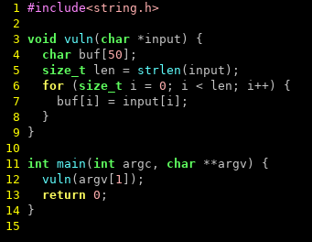
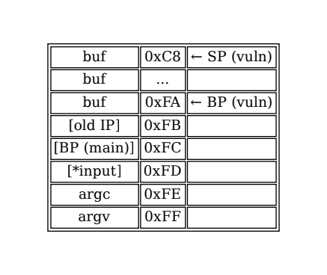
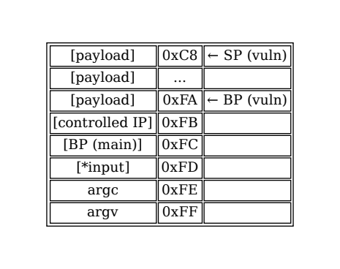
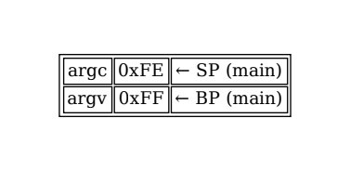
Technical Overview
<number>

Slide 4
ASLR
Randomize location of program in memory
Attacker doesn‘t know where to jump
Prevents code execution
Does not prevent DoS
Compile-time mitigation, no code changes needed
<number>

Slide 5
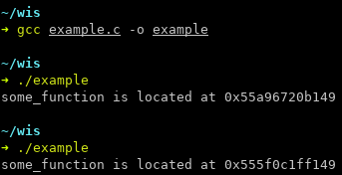
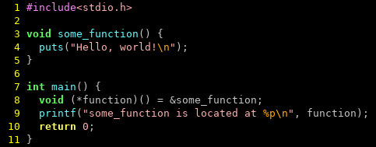
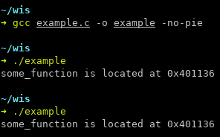
ASLR
<number>

Slide 6
NX
Memory can be either writable or executable
Attacker cannot supply shellcode directly
Code reuse still possible
Compile-time mitigation, no code changes needed
<number>

Slide 7
Stack Canary
Markers at the end of a stack frame
Invalid marker → Buffer overflow occurred
No code changes required
Only mitigates stack-based BOF
Knowledge of canary allows bypassing
<number>

Slide 8
RAD
Read-only stack for return addresses
Compared before return
Compiler extension
Only against stack-based BOF
<number>

Slide 9
Bounds Checking
Each indexing operation is checked
100% effective (where applied)
Non-trivial runtime overhead
<number>

Slide 10
Dependent Types
Value (size) is associated with a buffer
Only allow indexing with validated values
Language extension
Lot of work to use, but type inference helps
<number>

Slide 11
State of the Art
Major OS implement ASLR
Compilers implement PIE, NX, Stack Canaries (discussable defaults)
Mitigation | GCC? | clang?
PIE | No | No
NX | Yes | Yes
Stack Canary | No | No
<number>

Slide 12
State of the Art
Most techniques only prevent exploitation (code execution)
DoS might be just as critical
Only dependent typing and RBC actually prevent BOF
<number>

Slide 13
Conclusion
Use C, C++ and Fortran only if unavoidable
Viable alternatives exist (Rust, Go, Java, ...)
<number>

Slide 14
References
Use C, C++ and Fortran only if unavoidable
Viable alternatives exist (Rust, Go, Java, ...)
<number>

